Slide 1
Chapter 7:
Advanced SQL
Modern Database Management
10th Edition
Jeffrey A. Hoffer, V. Ramesh,
Heikki Topi
© 2011 Pearson Education, Inc. Publishing as Prentice Hall

Slide 2
Processing Multiple Tables
Using Subqueries
Subquery–placing an inner query (SELECT statement) inside an outer query
Options:
  In a condition of the WHERE clause
  As a “table” of the FROM clause
  Within the HAVING clause
  In the SELECT clause
Subqueries can be:
  Noncorrelated–executed once for the entire outer query
  Correlated–executed once for each row returned by the outer query
Notes:
We covered using join to process multiple tables. Another way is through use of subqueries.
Subquery is as the name suggests a query within the query.
Subquery can be placed in “
SELECT clause
FROM Caluse
HAVING clause
Two types:
Correlated – needs a link between the outer query and the subquery -> executes for each row returned in the query
Non-correlated – there is on inner link in the subquery. Executes once

Slide 3
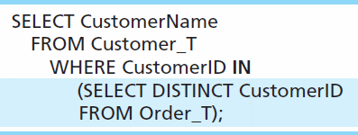
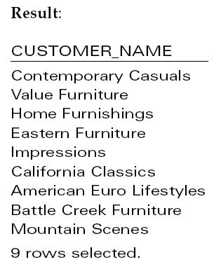
Subquery Example
Show all customers who have placed an order
The IN operator will test to see if the CUSTOMER_ID value of a row is included in the list returned from the subquery
Subquery is embedded in parentheses. In this case it returns a list that will be used in the WHERE clause of the outer query
Notes:
Subquery is what is in parenthesis.
In this example, the subquery can run by itself and return a result. Subquery is always in parenthesis
The subquery will return a list of all distinct or unique customer ID, and then that result is used to filter the outer query
This is a non-correlated subquery

Slide 4
Correlated vs. Noncorrelated Subqueries
Noncorrelated subqueries:
  Do not depend on data from the outer query
  Execute once for the entire outer query
Correlated subqueries:
  Make use of data from the outer query
  Execute once for each row of the outer query
  Can use the EXISTS operator
Notes:
Noncorrelated subqueries:
Do not depend on data from the outer query – just like we saw in the prior example the subquery could run by itself and you will see a list of customer ids
Execute once for the entire outer query – only executves
Correlated subqueries:
Make use of data from the outer query
Execute once for each row of the outer query

Slide 5
Correlated Subquery Example
Show all orders that include furniture finished in natural ash
  SELECT DISTINCT OrderID FROM OrderLine_T
  WHERE EXISTS
  (SELECT * FROM Product_T
  WHERE ProductID = OrderLine_T.ProductID
  AND Productfinish = ‘Natural ash’);
The EXISTS operator will return a TRUE value if the subquery resulted in a non-empty set, otherwise it returns a FALSE
The subquery is testing for a value that comes from the outer query
➔ A correlated subquery always refers to an attribute from a table referenced in the outer query
Notes:
The EXISTS operator will return a TRUE if there is any result (non empty) , or a value of false if NOTHING was found. Empty result
A correlated subquery always refers to an attribute from a table referenced in the outer query. In this case ProductID
Matching fields from the outer query with fields from the subquery

Slide 6
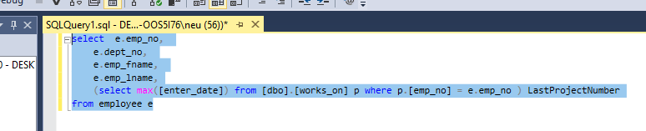
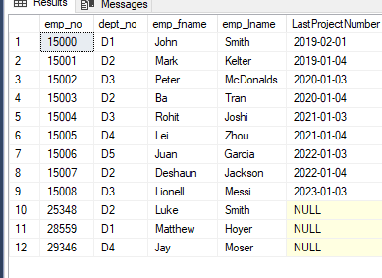
Subquery in SELECT
Notes:
select e.emp_no,
e.dept_no,
e.emp_fname,
e.emp_lname,
(select max([enter_date]) from [dbo].[works_on] p where p.[emp_no] = e.emp_no ) LastProjectNumber
from employee e
IS this correlated on noncorrelated?

Slide 7
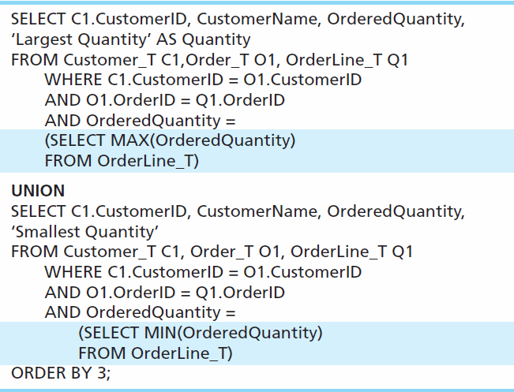
Union Queries
Combine the output (union of multiple queries) together into a single result table ( NO DUPS
First query
Combine
Second query
Notes:
UNION is used to combined output of multiple queries. Several times instead of writing one complicated query, it is easier and more readable to write two queries and combine the results.
That’s what union does

Slide 8
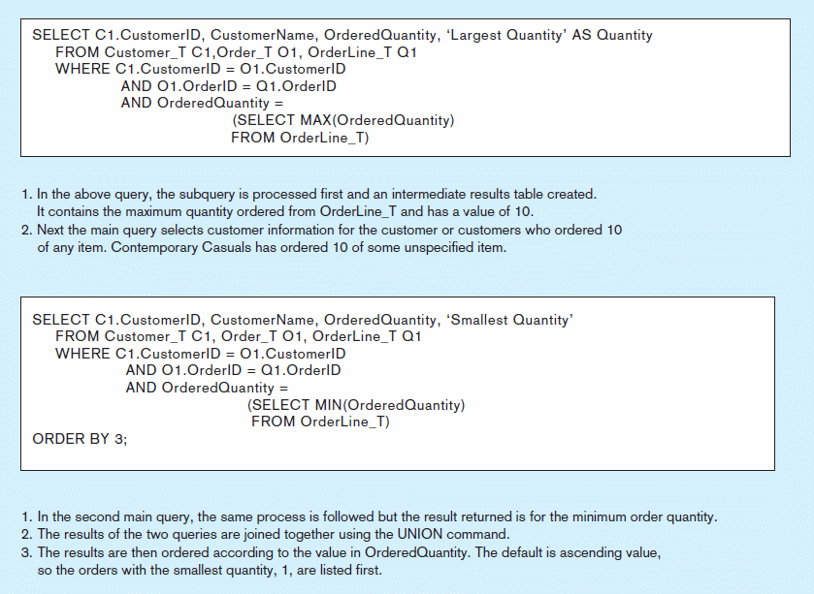
Figure 7-8 Combining queries using UNION
Note: with UNION queries, the quantity and data types of the attributes in the SELECT clauses of both queries must be identical
Notes:
When you union,
Data Types need to match, and the number of fields also have to match

Slide 9
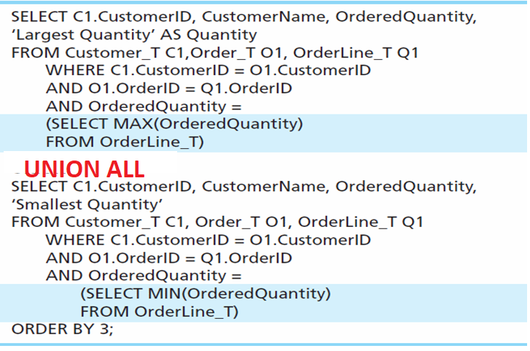
Union ALL Queries
Combine the output (union of multiple queries) together into a single result table ( WITH DUPS)
First query
Combine
Second query

Slide 10
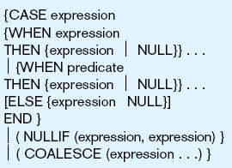
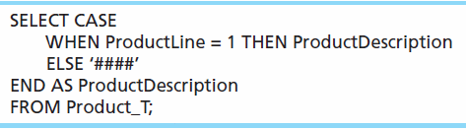
Conditional Expressions Using Case Syntax
This is available with newer versions of SQL, previously not part of the standard
Figure 7-9
Notes:
When the values from the DB is not stored exactly how you want to present, but the data could be derived or manipulated, using CASE WHEN ELSE

